Slide 1





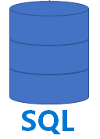





Cosmos DB
Azure Synapse Analytics
Operational Data
Cosmos DB
Link for Cosmos DB
Auto-Sync
SQL Query
Power BI
Transactional Store,
massive inserts,
key-value (JSON doc)
Analytical Columnar Store
Configuring Synapse Link for Cosmos DB means enabling Analytical Store in Cosmos DB and enabling automatic sync of data into it. So you can use SQL to query data from Analytical Store without slowing down the Transactional Store.
ML Studio
Azure Data Lake Storage (Files)

